Slide 1
Need Help?
Why having an Auxiliary can boost your Post.

Slide 2
Does your Post…
Want to increase membership and participation?
Want to win more Department and National awards?
Want to involve your community in more of your events?
Want to offer more meals to the public?
Want to serve more veterans, active-duty service members and their families?

Slide 3
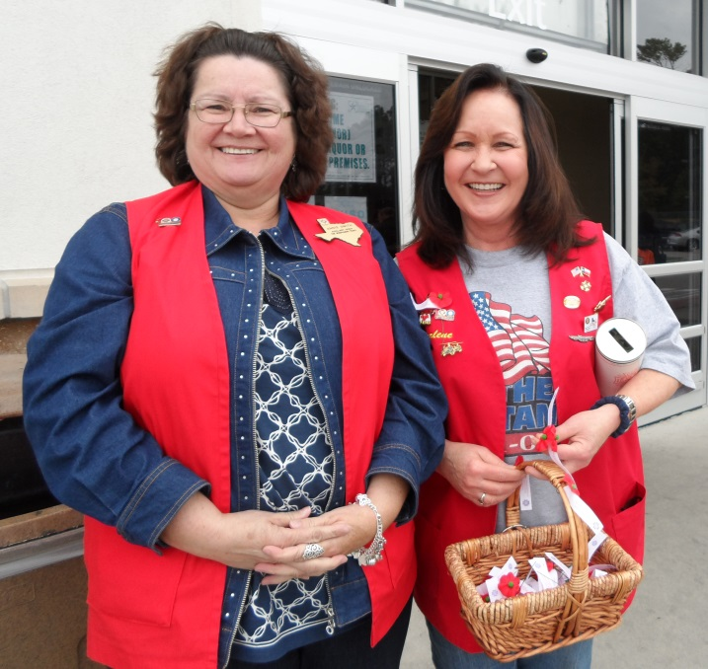
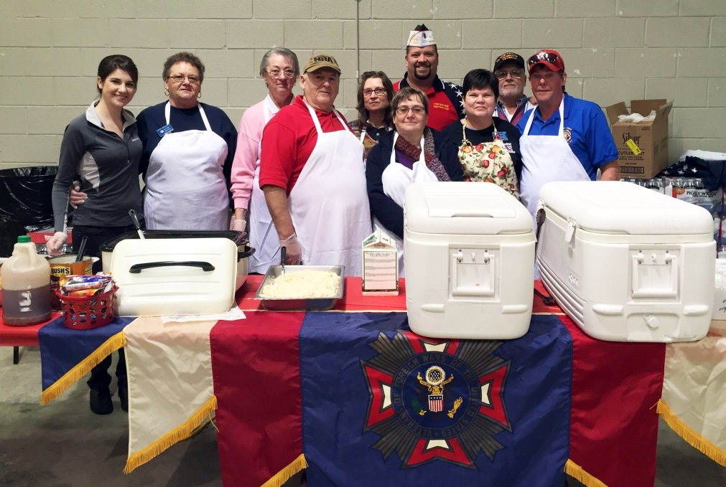
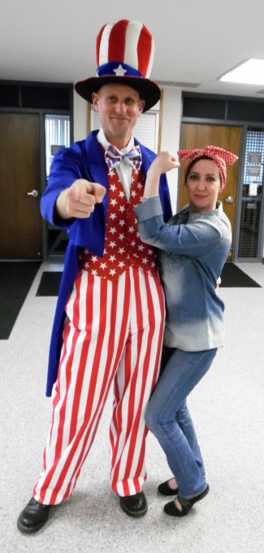
A VFW Auxiliary can help!

Slide 4
What an Auxiliary can do for YOU…
Open the doors to new members.
Help with family-oriented events.
Help spread the word on scholarship programs.
Offer valuable assistance for event preparation.
Assist with “Buddy”® Poppy Drives.
Boost the Post’s visibility in the community by being involved in more local activities and events.

Slide 5
By the Numbers…
What the Auxiliary did collectively in 2022-2023:
$9.9 million in total monetary aid to support veterans, active-duty military and their families combined with total monetary donations provided to veterans, service members and/or their families.
282,562 volunteer hours in VA and non-VA medical facilities.
Made 29,521 legislative contacts made to help pass or block important bills.
Worked with more than 182,654 youth.
Presented 410,765 Flags.

Slide 6
How does a Post start an Auxiliary?
Announce to all of your Post members in writing at least 20 days prior to the meeting where and when the vote to form an Auxiliary will occur.
In accordance with the VFW Bylaws, a two-thirds (2/3) majority vote of the Post members present is required to set into action the formation of a new Auxiliary to that Post.
If the vote it YES, then contact the Department President.
The Department President will assign an Auxiliary Organizer who will work on obtaining the required number of charter members (15) and filling out necessary paperwork.

Slide 7
Does it cost the Post anything?
The VFW Auxiliary Charter Kit fee is $100.00.
The Post and/or Department and/or the interested, eligible applicants may pay the Charter fee.
The Charter fee accompanies the completed Charter application.

Slide 8
How long does it take to start?
From the time your Post votes to have an Auxiliary, it could take anywhere from two (2) to four (4) months to get an Auxiliary up and running.
Hint: It takes less time for an Auxiliary to start helping your Post if there are already interested potential members before you vote!

Slide 9
What else do we need to know?
A VFW Auxiliary can be the best asset a Post has ever had.
Many hands make light work.
VFW Auxiliary members are extremely passionate about helping veterans, active-duty service members and their families.
We WANT to help the Post and its members!!!

Slide 10
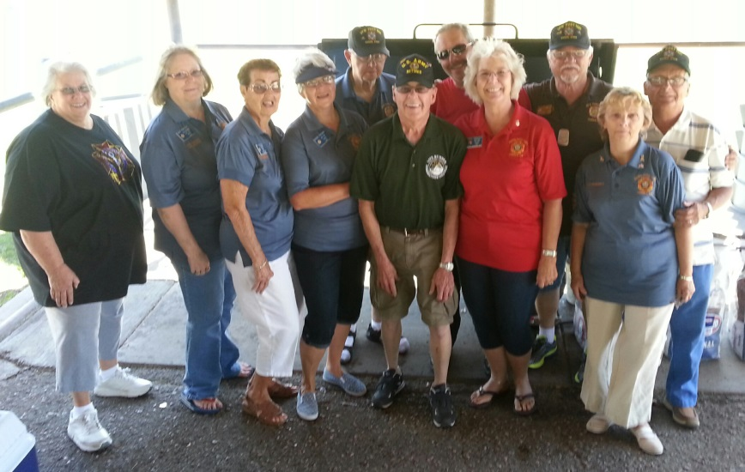
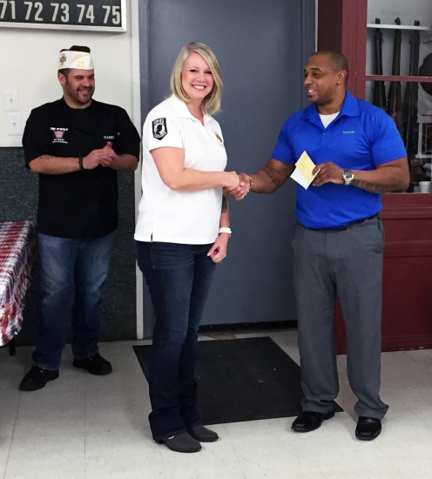
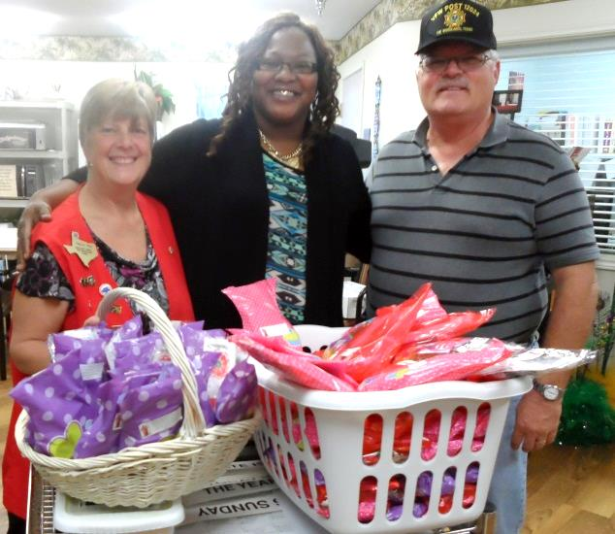
Contact us to get started!

